Slide 1
FLIGHT PRICE PREDICTION
SUBMITTED BY-
ASHISH CHAND

Slide 2
FLIGHT PRICE PREDICTION : PROBLEM STATEMENT
Anyone who has booked a flight ticket knows how unexpectedly the prices vary. The cheapest available ticket on a given flight gets more and less expensive over time. This usually happens as an attempt to maximize revenue based on –
1. Time of purchase patterns (making sure last-minute purchases are expensive)
2. Keeping the flight as full as they want it (raising prices on a flight which is filling up in order to reduce sales and hold back inventory for those expensive last-minute expensive purchases)

Slide 3
SOLUTION
work on a project collect data of flight fares with other features and work to make a model to predict fares of flights.
After collecting the data, you need to build a machine learning model. Before model building do all data pre-processing steps.
Try different models with different hyper parameters and select the best model.

Slide 4
EXPLORATORY DATA ANALYSIS
Exploratory Data Analysis(EDA) is an approach of analysing data sets to summarize their main characteristics, often using statistical graphics and other data visualization methods.
Here we check our data and understand what kind of data is present to us, it is supervised or unsupervised and then check the output/ target column is continuous or categorical.
Then visualize our data with the help of different plots with the help of python libraries such as Matplotlib and Seaborn.

Slide 5
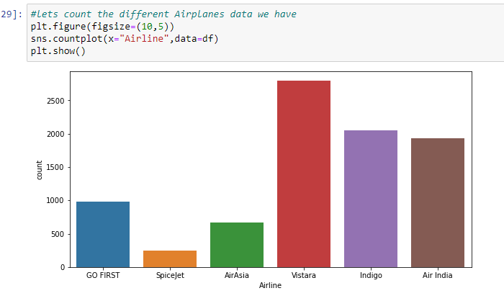
EDA(VISUALIZATION)
The plots used are-
Countplot: The countplot is majorly used for showing the observational count in different category based bins with the help of bars.

Slide 6
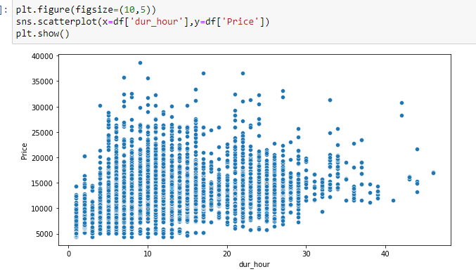
EDA CONTT.
Scatterplot to see the distribution of data among two columns. Scatter plots are used to observe relationship between variables and uses dots to represent the relationship between them. The scatter() method in the matplotlib library is used to draw a scatter plot. Scatter plots are widely used to represent relation among variables and how change in one affects the other.

Slide 7
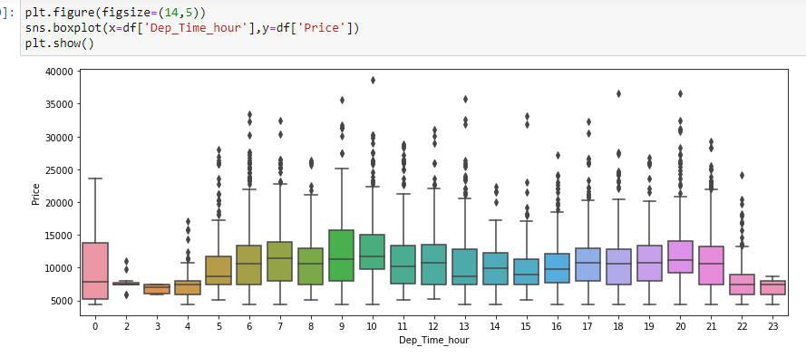
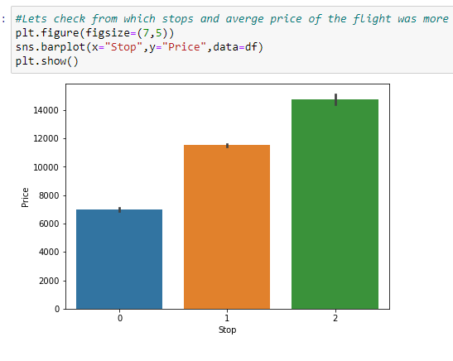
EDA CONTT..
Box plot- A Box Plot is also known as Whisker plot is created to display the summary of the set of data values having properties like minimum, first quartile, median, third quartile and maximum.
Bar Plot : A bar plot or bar chart is a graph that represents the category of data with rectangular bars with lengths and heights that is proportional to the values which they represent. The bar plots can be plotted horizontally or vertically.

Slide 8
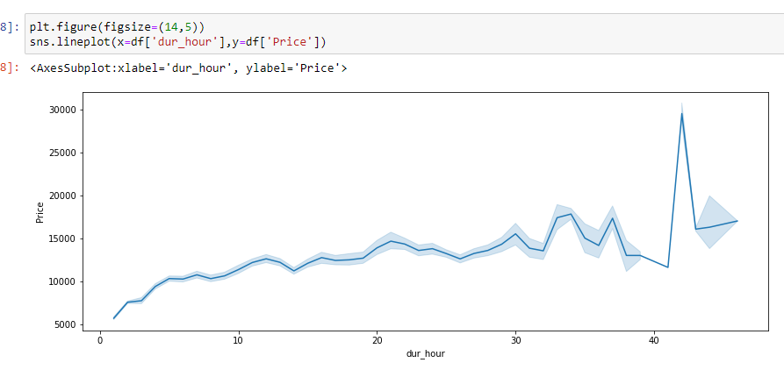
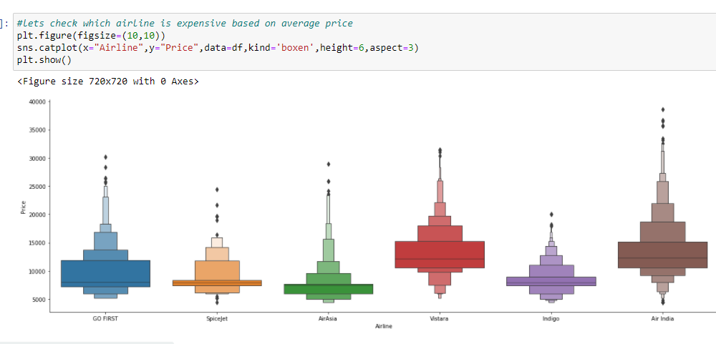
EDA contd.
Line plot: also known as a line chart, is a graph that uses lines to connect individual data points. A line graph displays quantitative values over a specified time interval.
Catplot: Catplot is a relatively new addition to Seaborn that simplifies plotting that involves categorical variables.

Slide 9
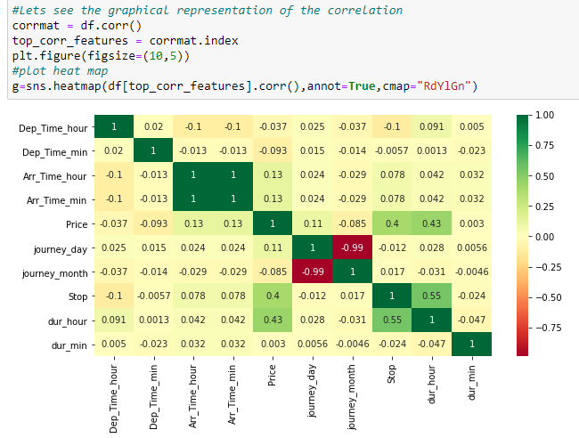
EDA cont.
Heatmap is used to see the correlation of columns.

Slide 10
Data Preprocessing
Step 1: Dropping unnecessary variables
remove those which are not actually related to our prediction like One Unnamed number.
Step 2: Checking the correlation
Now check the column which are highly correlated with the target column i.e. Target column.
Duration and Number of stops are high correlated with the Price.
Step 3: Changing the data type , convert the data type with the help of astype() function
Step 4: Clean the column values.

Slide 11
Cont..
After that perform the Univariate , Bivariate Analysis of the data with the help of the graph.
Air India and Vistara Airlines have the very expensive flight ticket.
Flight ticket frequently to get the maximize profits and fill more seats as soon as possible.
Early morning flights are less expensive.

Slide 12
FEATURE ENGINEERING
Converting the categorical columns into numerical with the help of the preprocessing technique i.e. Label Encoder.
Concating the train and test data but dropping the target column and storing into a variable.
Splitting the dataset into x and y for the model training and predicting.
Where x variable contain all the dependent columns except target column. While y contains only Target column i.e. Price.

Slide 13
Model selection
Step 1: Splitting the dataset into Training and Testing for the model prediction.
Step 2: Using Machine learning Algorithm:
1. Linear Regression
2. Lasso
3. Ridge
4. SVR
5. Random Forest Regressor
6. KNN

Slide 14
Model Evaluation Metrics
Mean absolute error : (MAE) represents the difference between the original and predicted values extracted by averaged the absolute difference over the data set.
Mean squared error: (MSE) represents the difference between the original and predicted values extracted by squared the average difference over the data set.
Root Mean squared error: (RMSE) is the error rate by the square root of MSE.
R2 score : R-squared (Coefficient of determination) represents the coefficient of how well the values fit compared to the original values. The value from 0 to 1 interpreted as percentages. The higher the value is, the better the model is.
Cross-validation is a technique that is used for the assessment of how the results of statistical analysis generalize to an independent data set. Cross-validation is largely used in settings where the target is prediction and it is necessary to estimate the accuracy of the performance of a predictive model.

Slide 15

Model Building
Step 1 : Splitting the data into the train test dataset.

Slide 16
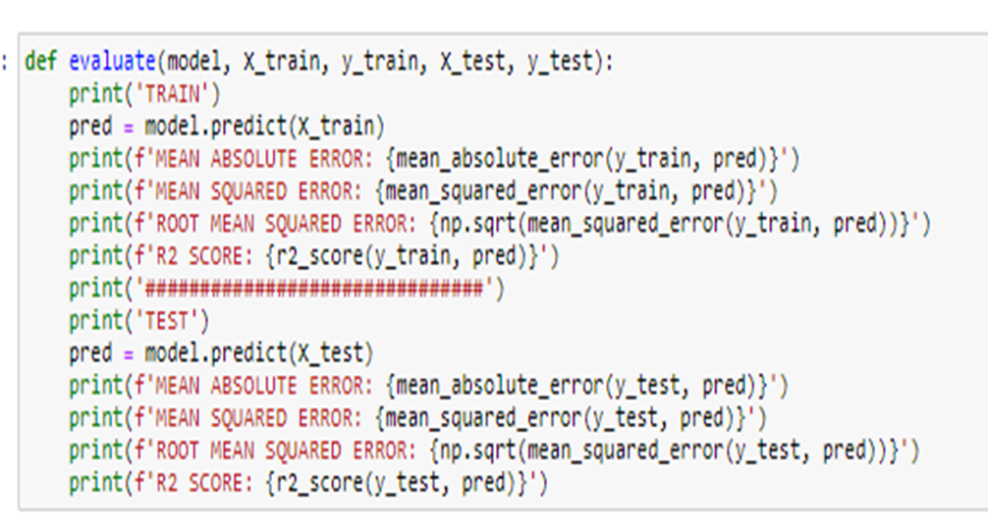
Model contt
Step 2: Model Training
Creating a function and run all the models on it.

Slide 17
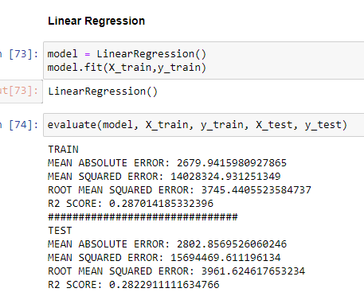
Model training
Linear Regression : Linear regression analysis is used to predict the value of a variable based on the value of another variable. The variable you want to predict is called the dependent variable. The variable you are using to predict the other variable's value is called the independent variable.

Slide 18
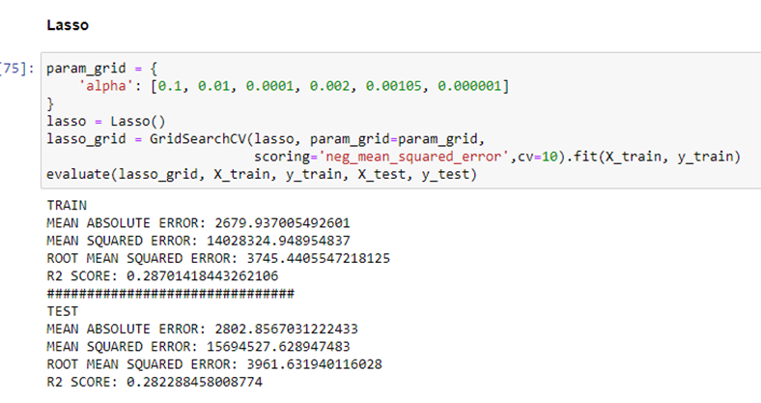
Machine learning algorithms..
Lasso : Lasso regression is a regularization technique. It is used over regression methods for a more accurate prediction. This model uses shrinkage. Shrinkage is where data values are shrunk towards a central point as the mean. The lasso procedure encourages simple, sparse models (i.e. models with fewer parameters). This particular type of regression is well-suited for models showing high levels of multicollinearity or when you want to automate certain parts of model selection, like variable selection/parameter elimination. Lasso Regression uses L1 regularization.It is used when we have more number of features because it automatically performs feature selection.

Slide 19
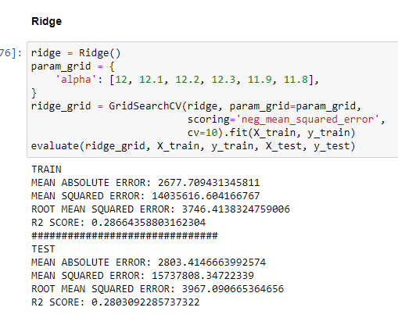
Algorithms..
Ridge: Ridge regression is a model tuning method that is used to analyse any data that suffers from multicollinearity. This method performs L2 regularization. When the issue of multicollinearity occurs, least-squares are unbiased, and variances are large, this results in predicted values to be far away from the actual values.

Slide 20
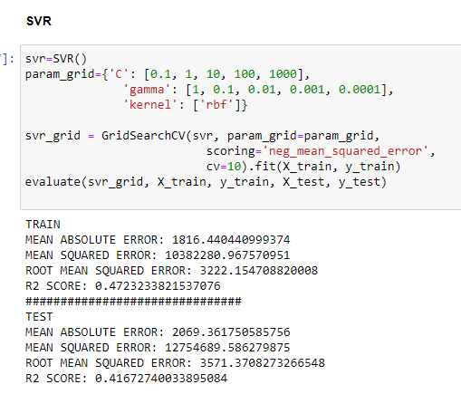
Algorithm contd..
Support Vector machine:Support Vector Regression is a supervised learning algorithm that is used to predict discrete values. Support Vector Regression uses the same principle as the SVMs. The basic idea behind SVR is to find the best fit line. In SVR, the best fit line is the hyperplane that has the maximum number of points.

Slide 21
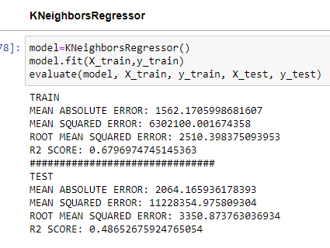
Alg. Contd..
K- Nearest Neighbors regression: KNN regression is a non-parametric method that, in an intuitive manner, approximates the association between independent variables and the continuous outcome by averaging the observations in the same neighbourhood.

Slide 22
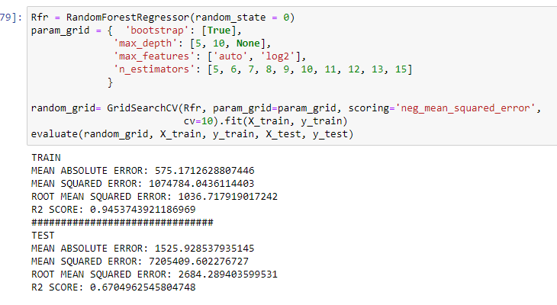
Alg. Contd..
Random Forest Regressor: is a supervised learning algorithm. The "forest" it builds, is an ensemble of decision trees, usually trained with the “bagging” method. The general idea of the bagging method is that a combination of learning models increases the overall result. Random Forest Regression is a supervised learning algorithm that uses ensemble learning method for regression. A Random Forest operates by constructing several decision trees during training time and outputting the mean of the classes as the prediction of all the trees.

Slide 23
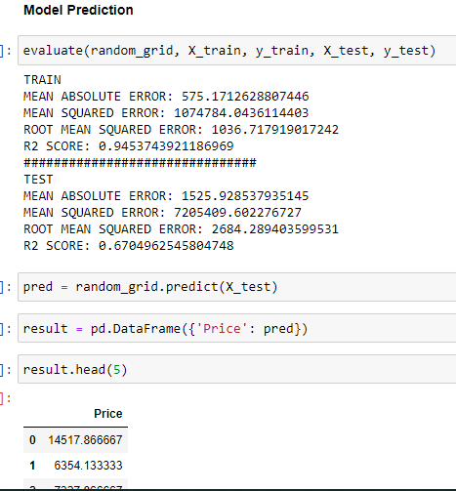
MODEL PREDICTION
Model prediction:

Slide 24
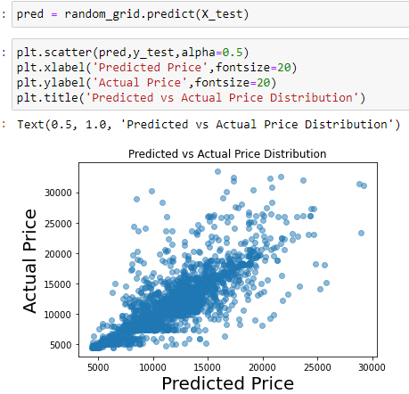
Prediction Contdd.
Lets visualize the prediction:

Slide 25
CONCLUSIONS:
The prediction of Flight price we find out that the Price is Correlated with the
1. Duration of the flight
2. Number of stops between the flights
That Means if the Duration of the flight is more the price of the flights increases and also when the number of stops is more the price also increases in that case.
Airfares move in small increments .
The ticket-fares tend to go up with time.
Near the departure date flight prices are very high.

Slide 26
CONCLUSIONS:
The best time to buy a cheap ticket to get less risk is to buy 10-20 days earlier of travelling date or more earlier than that ,1 month before is also good.
Air India and vistara flights tickets are very expensive.
The early morning flights are less expensive, after that increases.
In this project we use different models like Linear Regression, Lasso, Ridge, SVR, KNN Regression and Random Forest Regression.
Here we select the RandomForestRegressor model for our final model training and testing as it gives the R2 score which is highest among the all models we choose.

